Slide 1
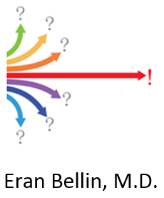
How to Ask and Answer your Research Question using Electronic Medical Record data
R embedded in Clinical Looking Glass

Slide 2
Observational Epidemiology - CLG capability overview

Slide 3
R provides an Object-Oriented Philosophy as well as a programing environment
Reusable functions allowing
Modification
Extension
Inheritance
Context Aware
Objects are transparent and fully documented

Slide 4
Patients are different from widgets in a warehouse or dollars in a financial report
Patients change over time
This identity change is critical
Consider Infant vs “same person”
Age 70
After a heart attack
With an ejection fraction of 30
With Rheumatoid arthritis
Medical record number is the same but different experiences through the trajectory of health-time makes the patient a different object.
Over time the patient belongs to different cohorts
Can answer different questions

Slide 5
“Belong to different cohorts” means that the patient must qualify by different criteria
Events that have happened to him
The temporal relationship of those events. Did they occur
Within a certain interval of time from each other?
During a specific calendar period when specific interventions were available?
During another event like a hospitalization instead of as an outpatient?

Slide 6
Clinical Analytic Application Needs to
Help the user structure his question so it is answerable
Surprisingly the questioner often is unable to articulate a question with sufficient clarity
Reduce near infinite questions to a series of tractable reusable patterns that can be sequentially invoked to cover a broad swath of questions
Be self-documenting so you know what you have asked and can share it
Build progressively more complex analytic objects made of more primitive objects
To progressively develop a mature question
Objects must be shareable and have shareable components so other users can benefit from the work that has already been accomplished through
Modification
Extension

Slide 7
Looking Glass Clinical Analytics
Built at Montefiore Medical Center
Original core S engine converted to R
In operation for over a decade and a half
1,000 people trained
More than 250 peer reviewed papers enabled
Used for
Research
QI
Education

Slide 8


Slide 9
Big Healthcare Data is useful when:
You transform it into temporally enriched information
The information answers an actionable question
You act upon the result of that question.
Results of that action are detectable
You have a methodology to evaluate the results
The implications of that evaluation drive your next action

Slide 10
Information must be “Patient Value Centric”
Payment Volume Centric | Patient Value Centric
How many admissions in 2011? | How many unique individuals admitted in 2011?
How many visits for hypertension? | How long does it take us to control hypertension?
How much do we spend on drug X? | How rapidly did patients improve on drug X?
How rapidly did patients improve on drug X?
Notes:
Timeframes must be relative to an individual’s experience
Calendar timeframes in business quarterly, monthly, “slice and dice” through events but give no sense of temporal relationship to the the patient experience
Patient specific clinical events must have temporal relationship
To be accountable for care, means to know what has happened to a patient over time and how well you have delivered that care or achieved a patient specific objective.
A group of patients each with his own start time forms a clinical cohort.
The clinical cohort is is at the center of patient-centric information. Let’s look at the power of the cohort paradigm”

Slide 11
Patient-centric cohort
key concept

Slide 12
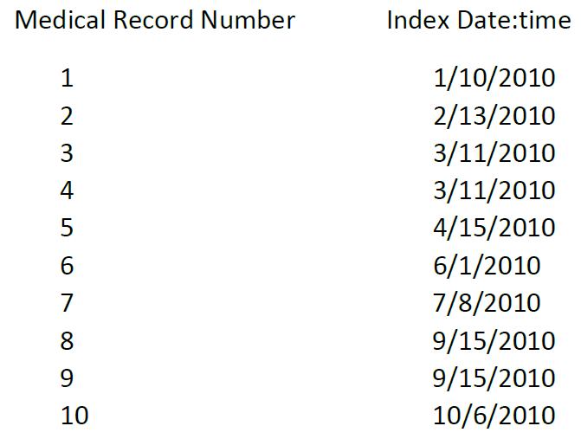
Spreadsheet Representation of the Cohort

Slide 13

Calendar Graph representation of Patient-centric cohort
1/1/2010
1/1/2011
1/1/2012
Patient #
1
0
Diabetes Control
2
0
3
0
0
= index date
4
0
(start therapy)
5
0
= outcome
6
0
(achieve lab value)
7
0
8
0
0
= patient experience
9
0
10
0
What % of new diabetic patients were controlled in the year 2010?
4 / 10 = 40%
Notes:
This way of looking at data is typical of financial reporting with rules for fiscal years and the like but let’s hope this is not the reporting approach that our EMR vendors adopt.

Slide 14
Cohort concept (cont)
Enrollment
1 Year
2 Years
Patient #
Diabetes Control
3
0
8
0
0
= index date
9
0
(start therapy)
1
0
= outcome
4
0
(achieve lab value)
7
0
5
0
0
= patient experience
10
0
2
0
(same data, re-sorted)
6
0
What % of new diabetic patients were controlled within 1 year?
5 / 10 = 50%
Notes:
Instead, look at the patient specific approach of the cohort paradigm.
<review diagram>
The measurement is different. The methods matter not just for intellectual clarity but also for eliciting the right behavior from those who are trying to manage to the metrics. The doctor who won't accept a sick patient in November because it will damage his annual metric is responding rationally to a perverse poorly designed metric.

Slide 15
Suggested Reading: Riddles in Accountable Healthcare A primer to develop analytic intuition for medical homes and population health by Eran Bellin (Amazon, Kindle)
Chapter 8 : Am I my Brother’s Keeper?
– the longitudinal Healthcare Paradigm

Slide 17
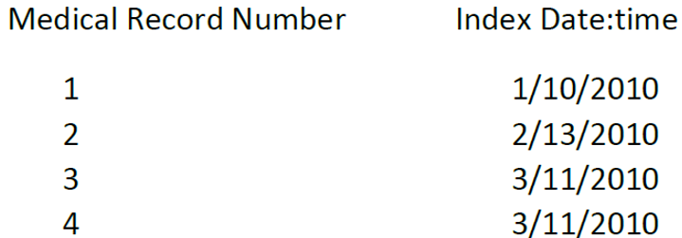
A cohort is a group of patients
With each person represented only once with
Medical record number
Index date

Slide 18
Let’s build a Diabetic cohort
Index
Line
Condition
line

Slide 19
Condition line has three component objects
Event Object provides the event that qualifies a patient for cohort membership
Admission diagnosis
Medication in patient or outpatient
Lab test
Duration – defines the time you look for the event
Calendar interval between date and date
Identified event in another condition line - during a hospitalization
Temporal window anchored at another event date:time
Demographics define the characteristics of the patient
Age
Gender
Ses…

Slide 20
Index line (cohort object)
Assigns to each member of the cohort an index date
By pointing to the condition line whose event date will be the index date
If the chosen condition line has more than one event per person
The index line choses one event per person
Earliest
or
Latest

Slide 21
Diabetes Demo
Bad Diabetes
Bad Diabetes with follow up

Slide 22
Temporal Mind Map for Diabetes Control

Slide 23
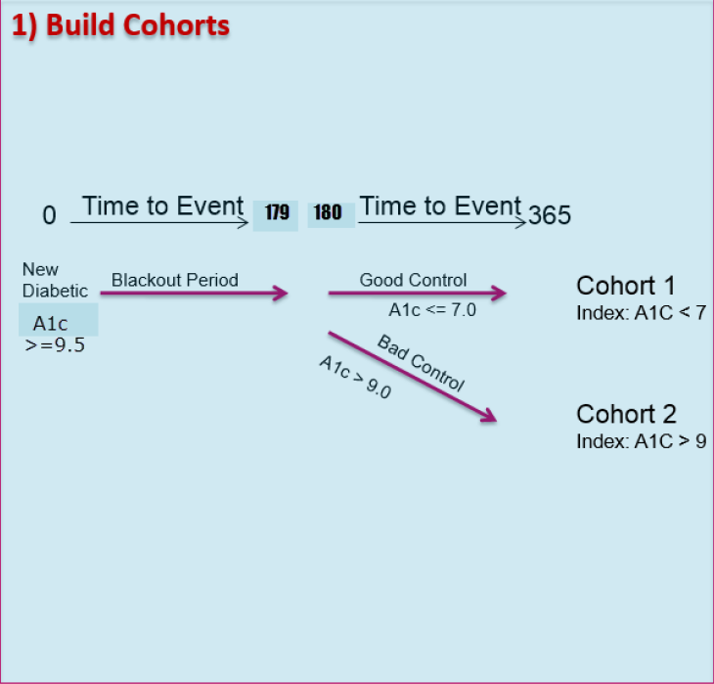

Slide 24
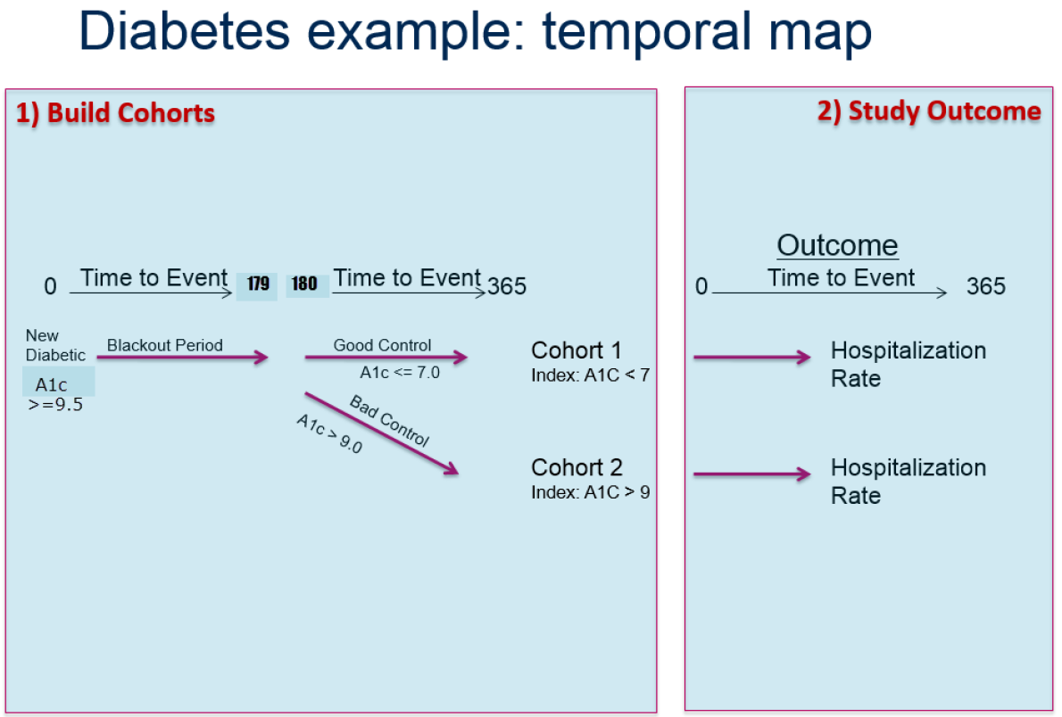

Slide 25
Cohort Object moved to Study Designer environment
Apply Study Method to cohort object
Follow the Health-Time trajectory
To hospitalization
Hospitalization2

Slide 26
Time to Outcome Analytic Pattern
Time to Outcome Hospitalization importance of index
How is the Question different if you
Index on repeat
Index on Original HgbA1c

Slide 27
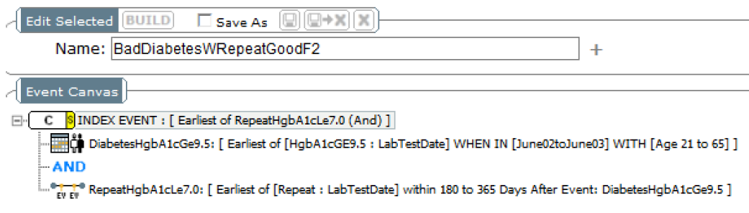
Index on Repeat

Slide 28
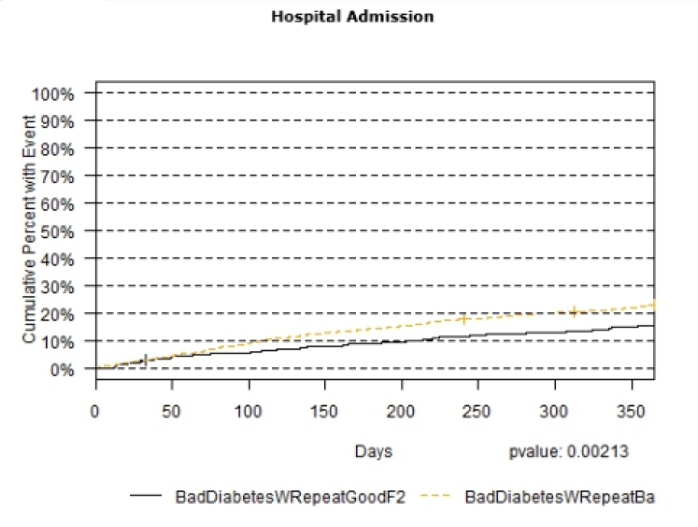
Index on Repeat

Slide 29
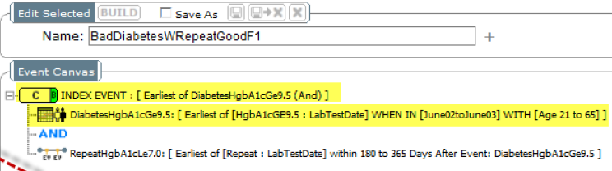
Index on Original HgbA1c

Slide 30
Index on repeat HgbA1c
Bring both cohort Newly indexed to study designer
Repeat Time to Outcome – hospitalization
What Question are you asking and answering? How does it differ?

Slide 31
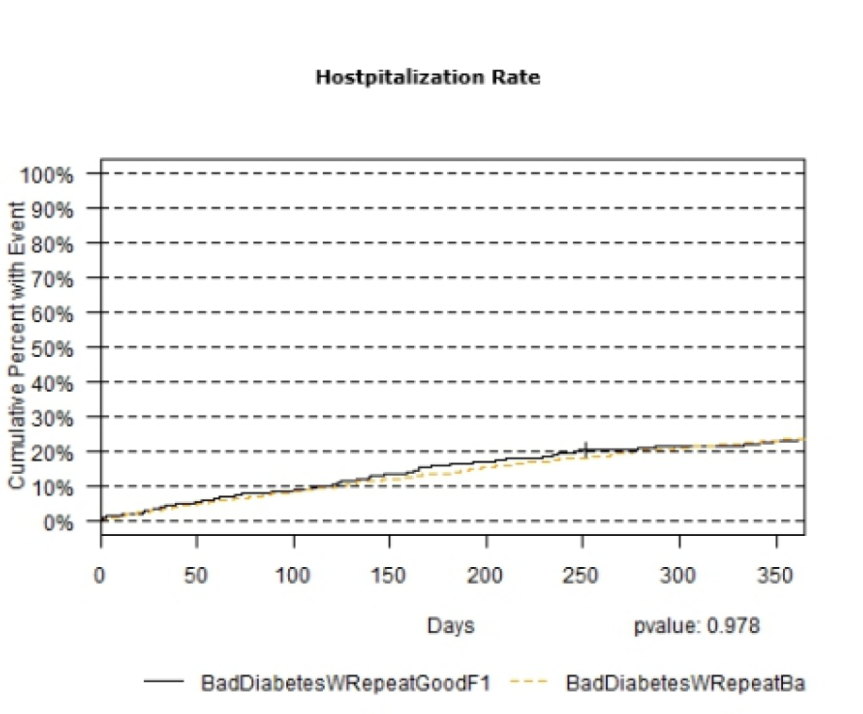
What Question is being answered?

Slide 32
While you are trying to achieve good Blood glucose control, what is Cumulative incidence of hospitalization during the year of your efforts to control?

Slide 33
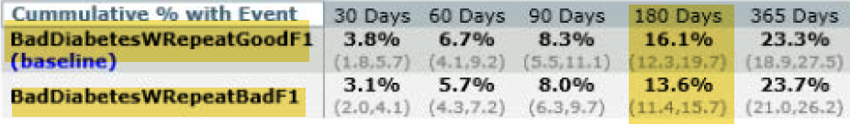
There is an initial hospitalization cost -

Slide 34

Email: ebellin@montefiore.org
eranbellin@gmail.com
Looking Glass now available as a commercial product
Looking Glass Clinical Analytics
Streamline Health
Atlanta, Georgia
43 videos available on Youtube
Search: Clinical Looking Glass
Youtube Eran Bellin

